Slide 1
Convolutional Neural Network
이론 II

Slide 2
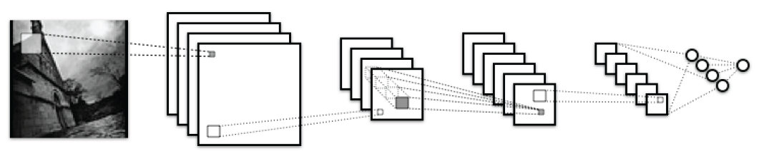
CNN overall procedures
Input Image
Convolutional Layer
Pooling
MLP
Softmax Output

Slide 3
CNN overall procedures
Softmax Output
MLP
Pooling
Convolutional Layer
Input Image

Slide 4
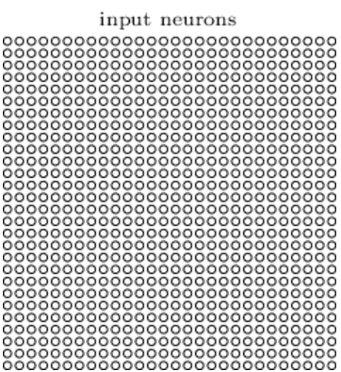
Input Image
1D - Input neurons
2D - Input neurons
Input Image

Slide 5
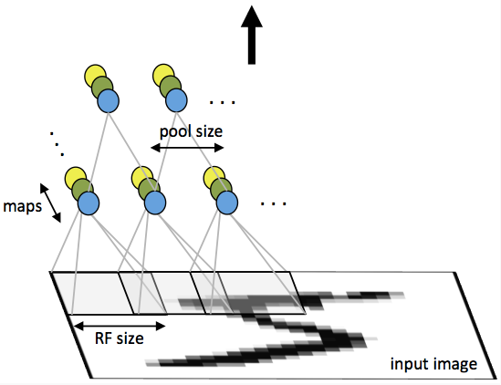
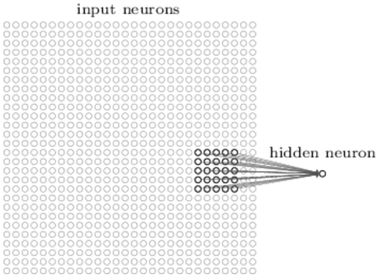
Convolutional Layer
Input neurons
Convolutional Layer
Hidden neuron
Input Image

Slide 6
Traditional Neural Network
Input layer
Hidden layer
Output layer

Slide 7
CNN - Sparse Connectivity
Input layer
Hidden layer
(Feature map)
Output layer

Slide 8
CNN – Dimension shrinkage ( + Pooling)
Input layer
Hidden layer
(Feature map)
Output layer

Slide 9
Cross-Correlation Input (or Hidden) layer with weight
Input layer
Hidden layer
(Feature map)
Output layer
(Receptive field)

Slide 10
Shared Weight representation
Input layer
Hidden layer
(Feature map)
Output layer

Slide 11
Shared Weight representation
Input layer
Hidden layer
(Feature map)
Output layer

Slide 12
Shared Weight representation
Input layer
Hidden layer
(Feature map)
Output layer

Slide 13
Shared Weight representation
Input layer
Hidden layer
(Feature map)
Output layer

Slide 14
Shared Weight representation
Input layer
Hidden layer
(Feature map)
Output layer

Slide 15
Shared Weight representation
Input layer
Hidden layer
(Feature map)
Output layer

Slide 16
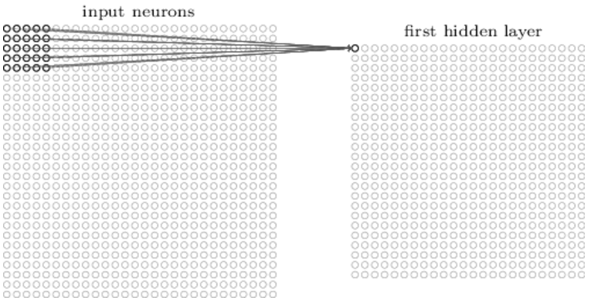
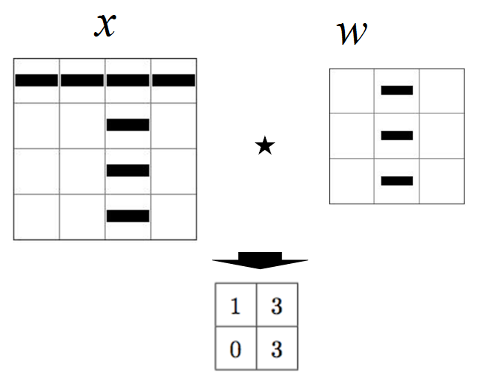
Multiple Feature maps
Input neurons
First hidden layer
Convolutional Layer
Input Image

Slide 17
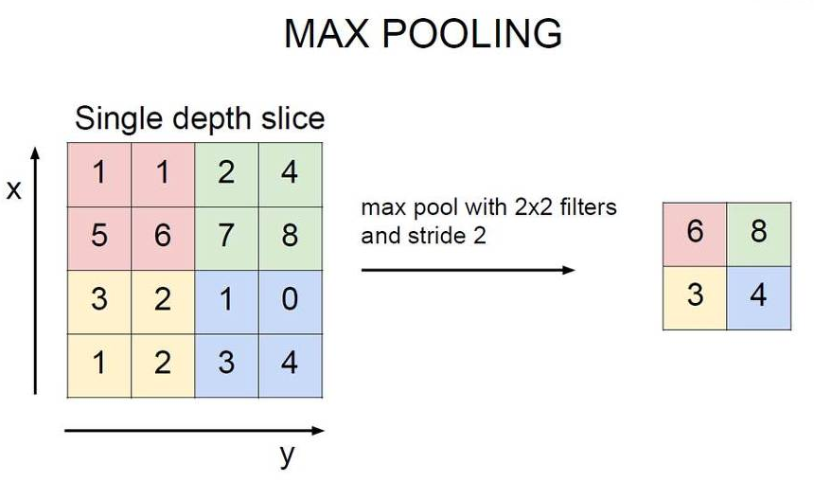
Max Pooling
Pooling
Max pooling with
2x2 filters and stride 2
Convolutional Layer
Input Image

Slide 18
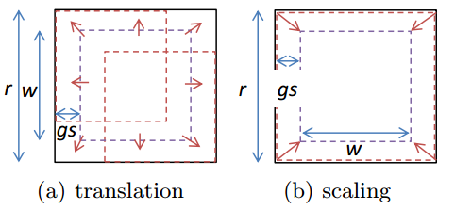
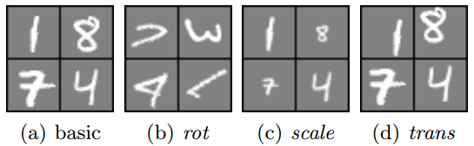
Why pooling?
1. Low computation (계산 량 감소)
2. Translation invariance
(병진운동에 대한 불변성)
3. Transformation invariance
4. 크고, 작은 그림 모두 Detect 할 수 있다.
Pooling
Convolutional Layer
Input Image

Slide 19
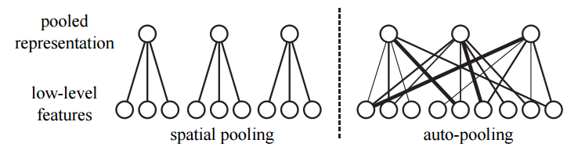
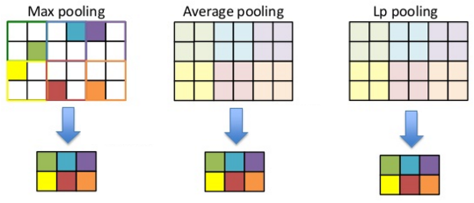
Several types of Pooling
Pooling
Convolutional Layer
Input Image

Slide 20
Transform data dimension before MLP
1D - Output neurons
2D - Output neurons
MLP
Pooling
Convolutional Layer
Input Image

Slide 21
Multilayer Perceptron (MLP)
Input layer
Hidden layer 1
Hidden layer 2
MLP
Pooling
Convolutional Layer
Input Image

Slide 22
Softmax Output
Hidden layer 2
Output layer
Softmax Output
MLP
Pooling
Convolutional Layer
Input Image

Slide 23
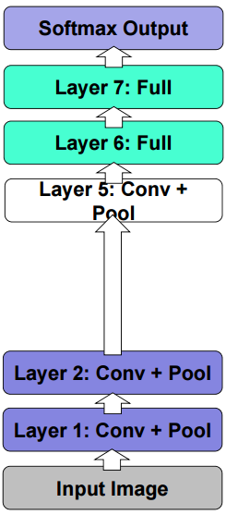
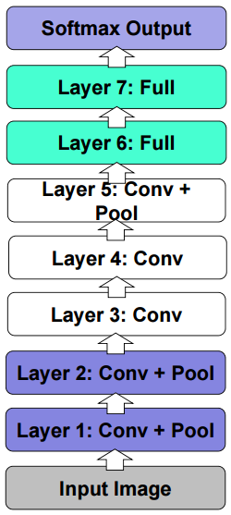
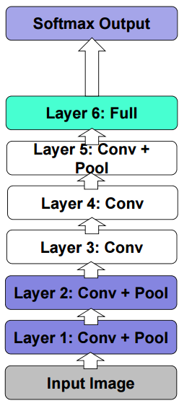
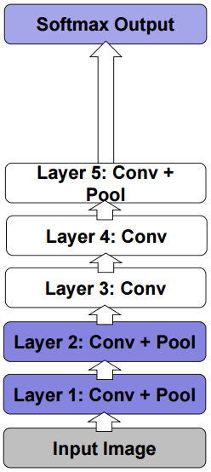
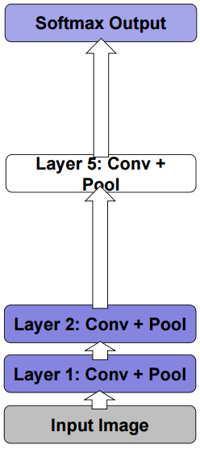
Several types of CNN

Slide 24
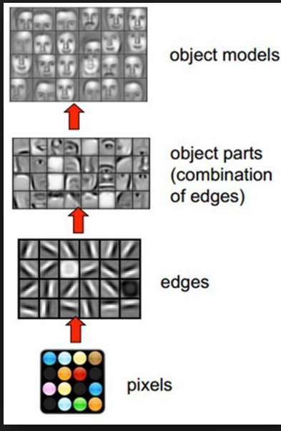
Intuition for CNN
Softmax Output
MLP
Pooling
Convolutional Layer
Input Image
Notes:
Cross correlation 의 직관적 이해

